Slide 1

Google Play Store Data - Case Study
Heather McLauren
Blake Samaha
Saif Kasmani

Slide 2
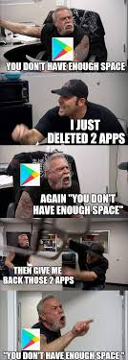
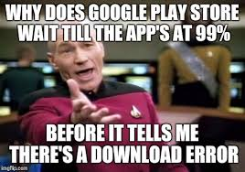

Slide 3
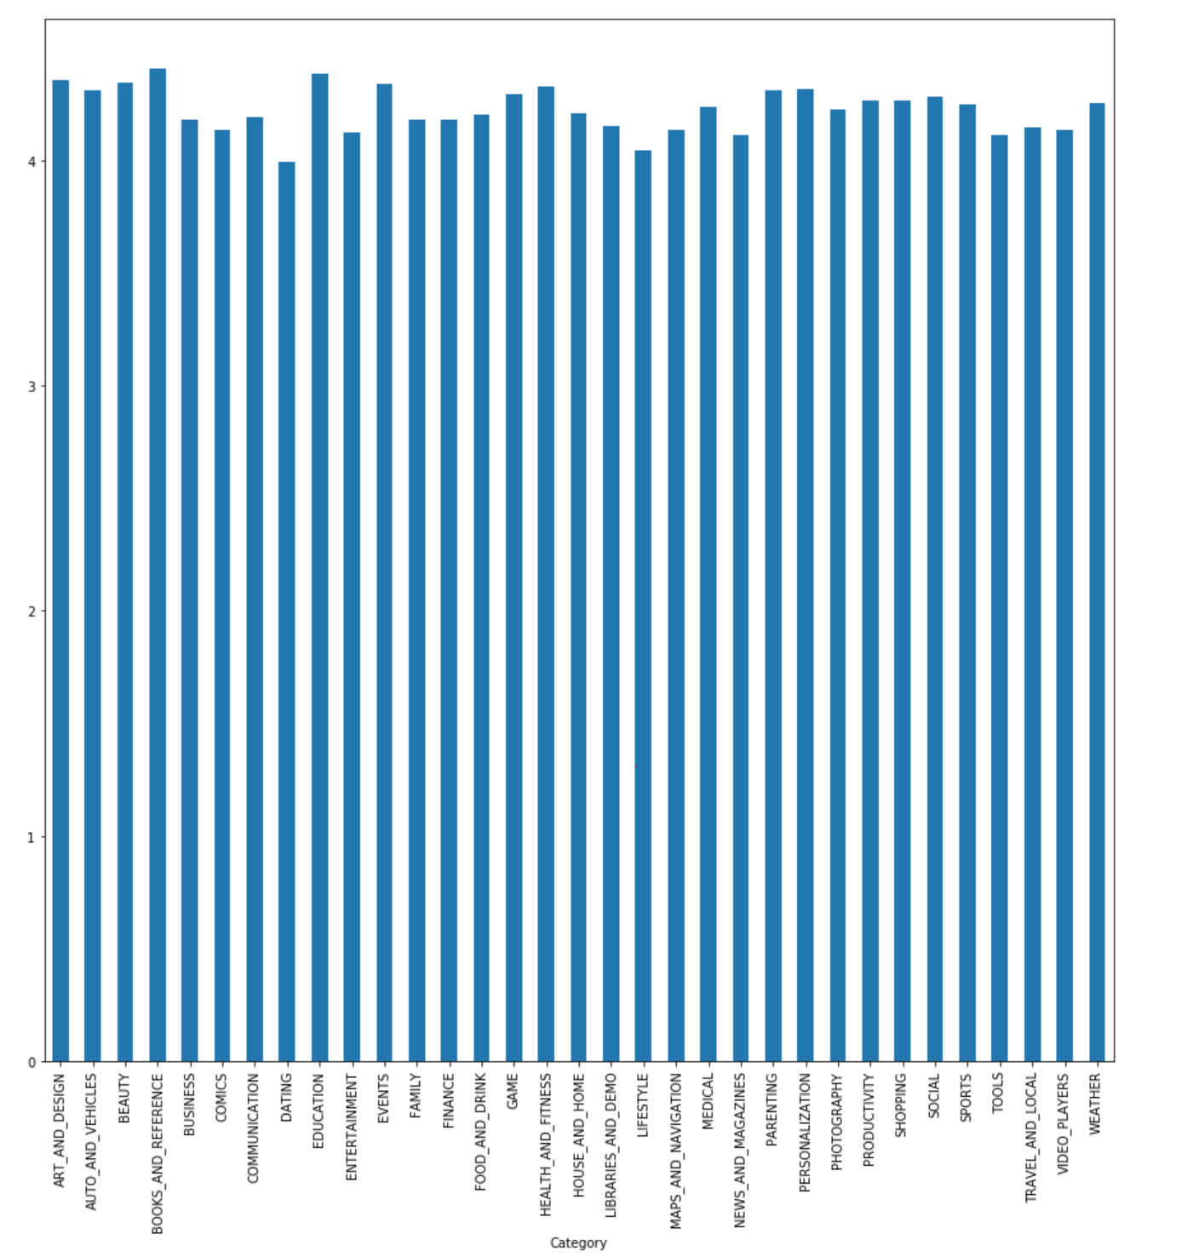
Question 1
Q:Which category, in your opinion, has the best ratings?
A: The BOOKS_AND_REFERENCE category with a ratings mean of 4.41
Q: How are you measuring best ratings?
A: First we filtered all apps with less than 100 ratings. We wanted to ensure we have enough ratings to have normalized distribution of our ratings for each app. After that, we simply took the mean rating of all categories. Once that was complete took the highest mean --not easily seen in our graph-- is the Events category with a ratings mean of 4.41

Slide 4
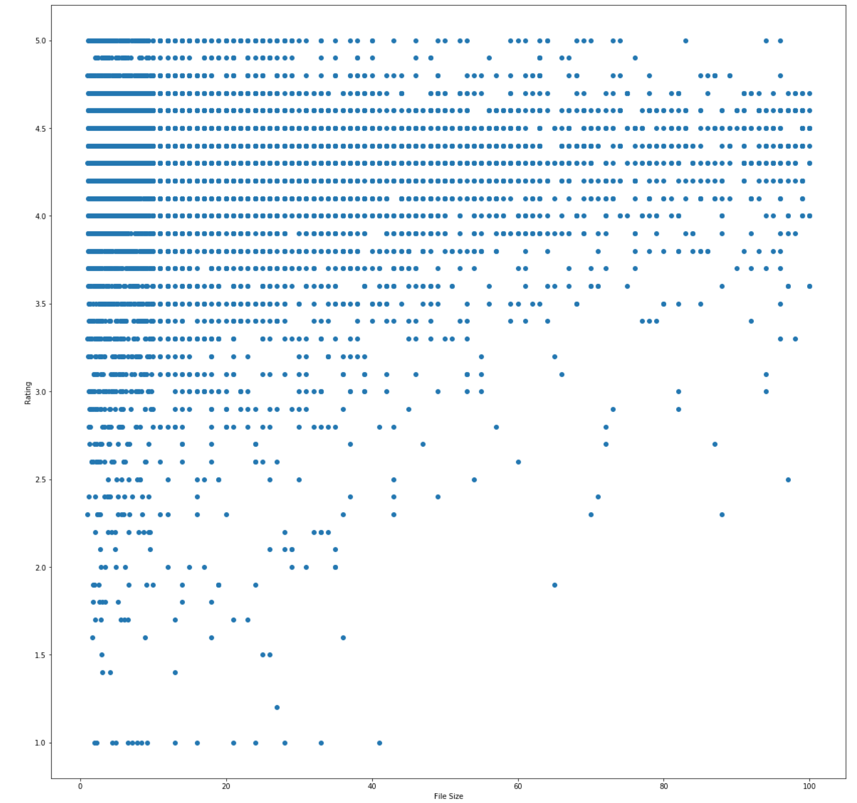
Question 2
Q:Is there a relationship between ratings and size?
A: No, the correlation coefficient between ratings and size was 0.07.
Q: How did you measure the relationship? Why did you choose this measurement?
A: First the data was split between Megabytes and kilobytes so we decided to few kilobyte sized apps and only measure the megabyte size apps. We used the correlation coefficient which returns a number -1 to 1. The closer to 1 or -1 the stronger the two variables are related. Our value of 0.07 is an extremely weak trend.
Q: Please create a scatterplot of size vs ratings to demonstrate the relationship or lack thereof.
A:

Slide 5
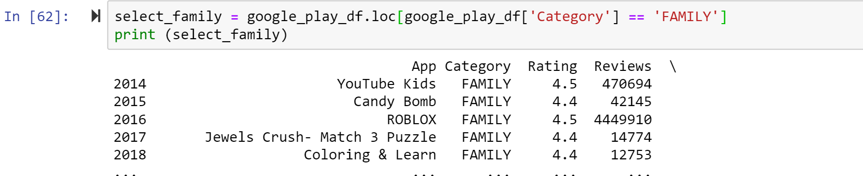
Question 3

Slide 6
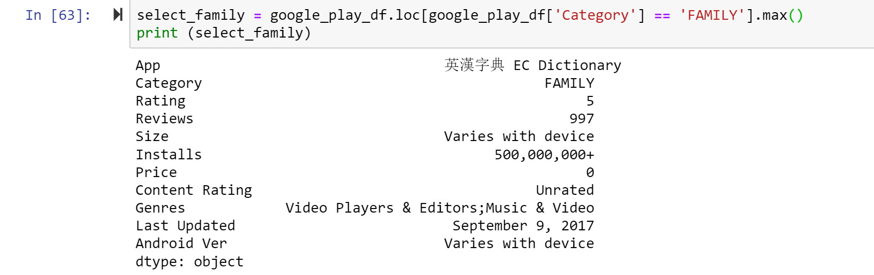
Question 4
Top App in the Family Category EC Dictionary which is a Chinese to English app

Slide 7
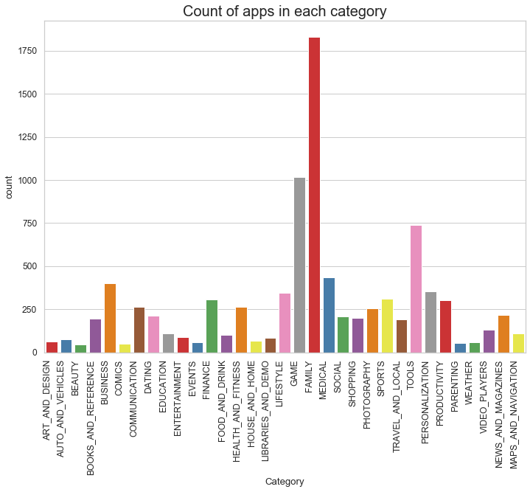
Question 5
Q: What is something interesting you found about your category in relationship to the rest of the data?
A: Number of applications in the family category was the highest compared to other categories.

Slide 8
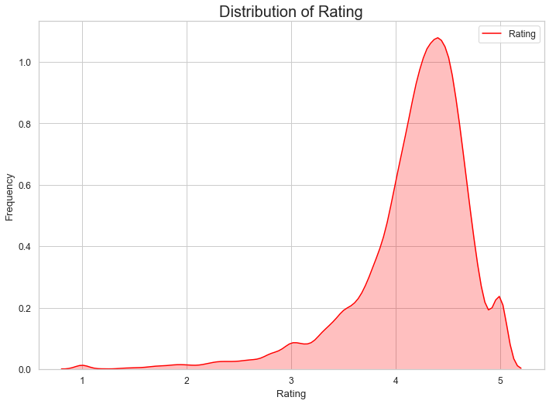
Question 6
Q. Anything else we should know about this dataset?
Average of rating of applications in store is around 4 which is high overall.

Slide 9
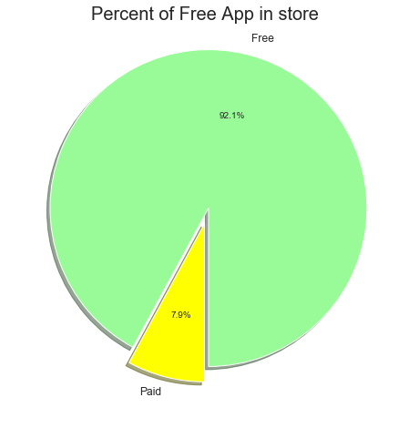
Percentage of Free Apps in store is 92.1% and paid apps is 7.9%. Highest cost for a paid app is 400$

